Slide 1

Poe injector
Parman company – second demo 03/06/06
Mentor : mrs shaterzade members: arezoo savlani, mehrad afshari nazari

Slide 2
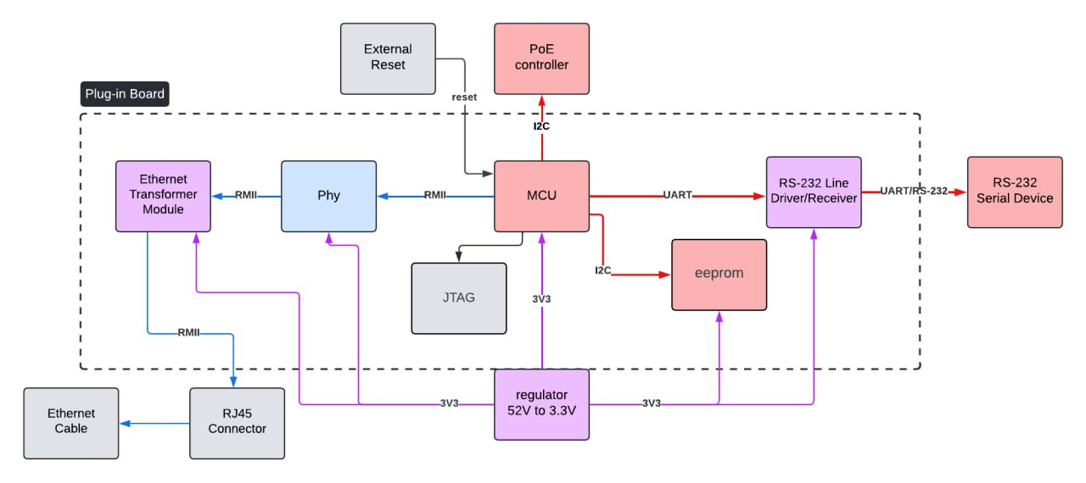
IntrodUCTION

Slide 3
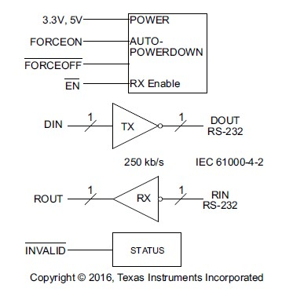
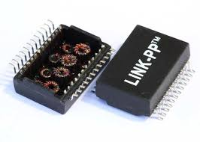
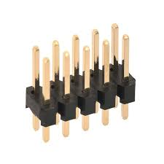
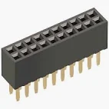
ICs
MCU:
STM32F765
AT24C04D_SSHM_T(eeprom)
JTAG
Ethernet Path
DP83848KSQ_NOPB
LP82453NL Transformer
Communication Path: MAX3232EIPW Driver
Port: 2x10 Pin Male/Female Header

Slide 4
SCHEMATIC DESIGN PROCESS
A LIB file that has a parts we need and were made in the past
Creating our pages with a default size and then we understand that some IC s are very big and also they have part types. So if we had added all of them to one page it would have been complicated. So we planned to have 5 pages look like our sections in previous part. Then we put related parts in each page. (More details in First Design part)
Putting parts in the pages.
Connecting the pins:
Checking datasheets
find pins which we need to use and know about type of them. (I ,O ,I/O)
Which pins coupling capacitors or any resistor between GND or VCC.
After that we connected our pins and go through checking it more. (More details in Milestones part)

Slide 5
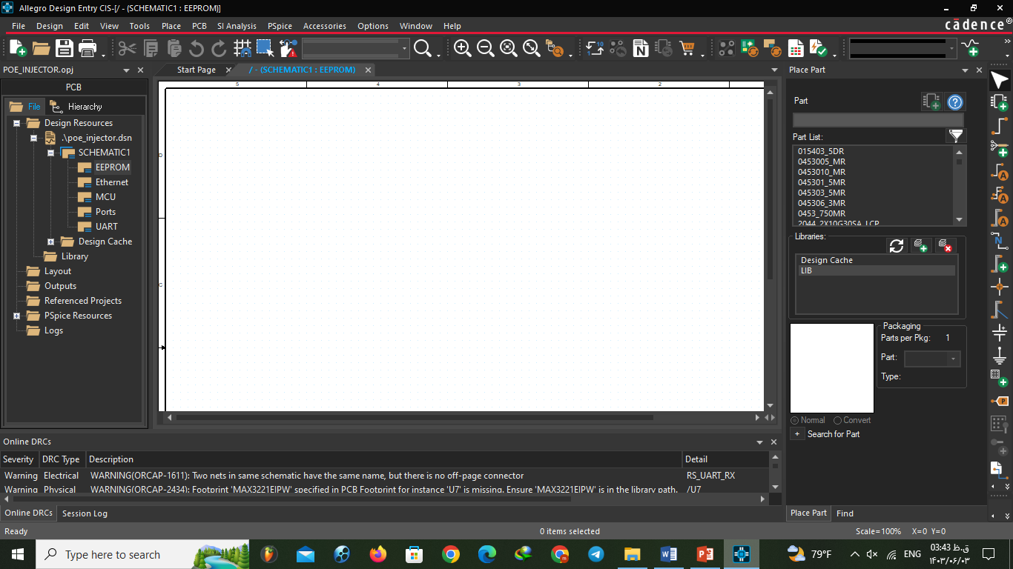
Cadence features
1- Place Net Alias:
This feature is for naming parts. It has some rules that will be mentioned in standards part.
2- Off-Page connector:
To connect pins from two different pages.
For power and ground you don’t need to define off-page connector because they are global nets.
There is three type of off-page connector and it depends on pins type: bidirectional – input – output
(Note: Using one off-page connector in one page is enough. If you want to use it more than once you don’t need to add extra off-page just add it with net name)
3- Place Bus:
This is for defining bus in schematic. At the first we used it for our 4-bit data but then we understand that we need just two bit so we removed. (More details in First Design part)

Slide 6
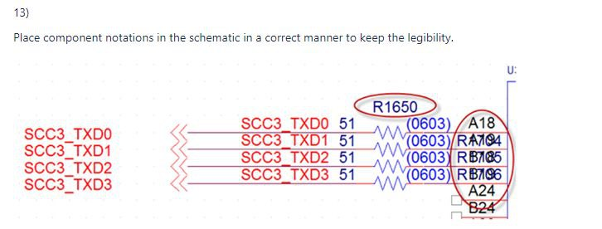
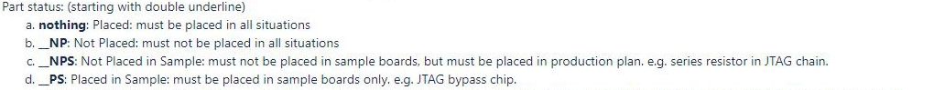
Standards
Try as much as you can to not use specific letter (/ or + or (Use underline instead of space)
Put numbers for your pages and parts.
Try not to use global nets with same voltage and different names.
Elements names(Page number + number or letter like R313: resistor 13 of page 3)
Name your design file with date of edit. (Like: POEICPT1_R1_2024_8_13_3)
:

Slide 7
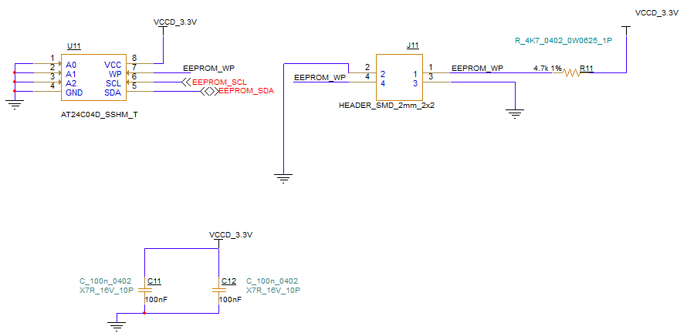
First Design:
01:EEPROM

Slide 8
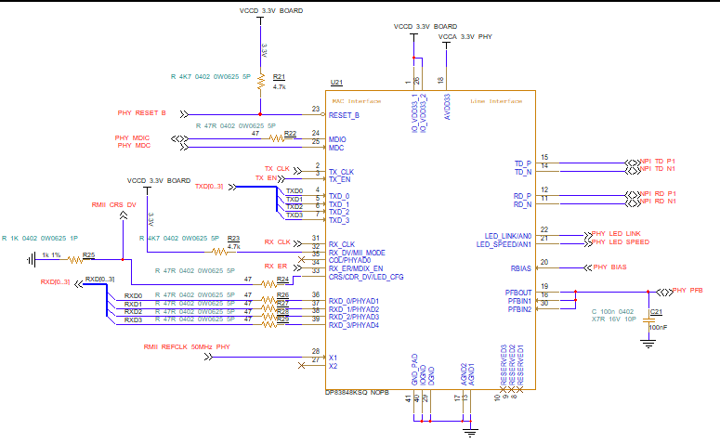
02:Ethernet

Slide 9
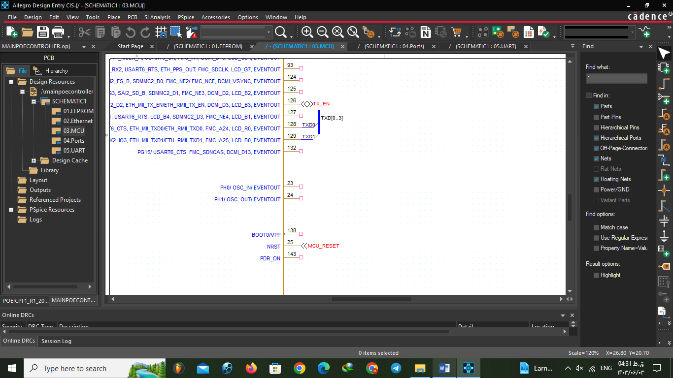
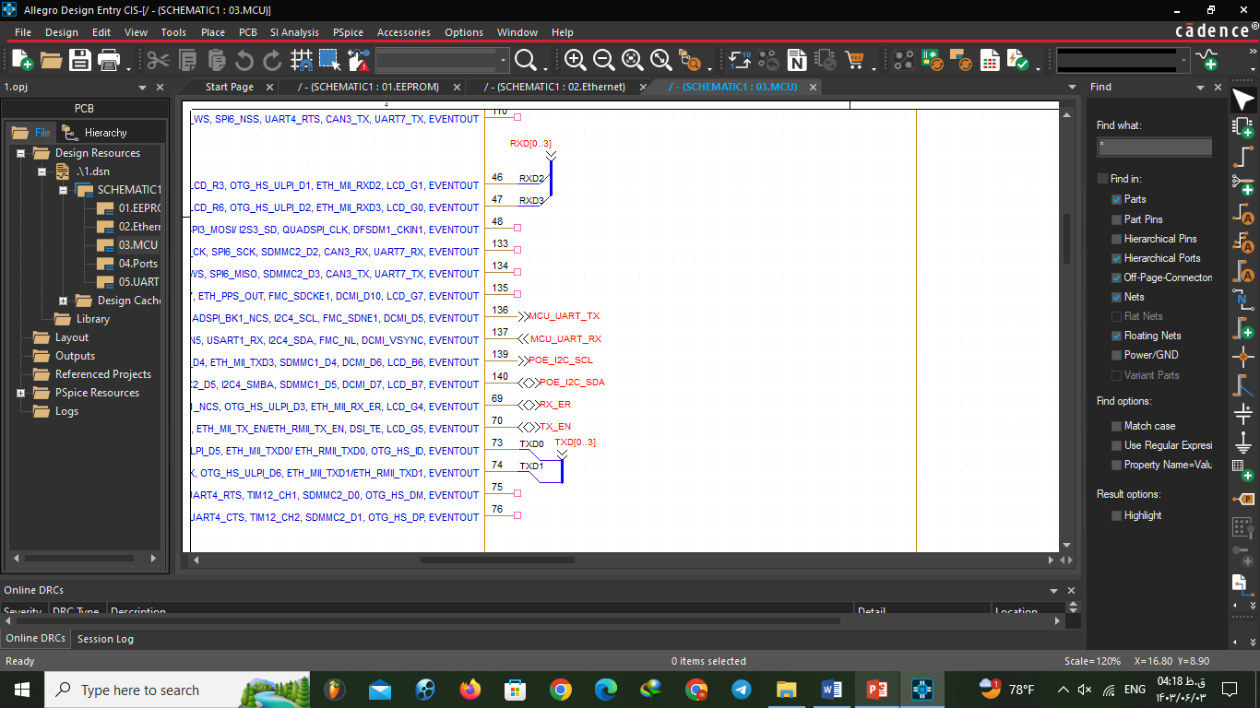
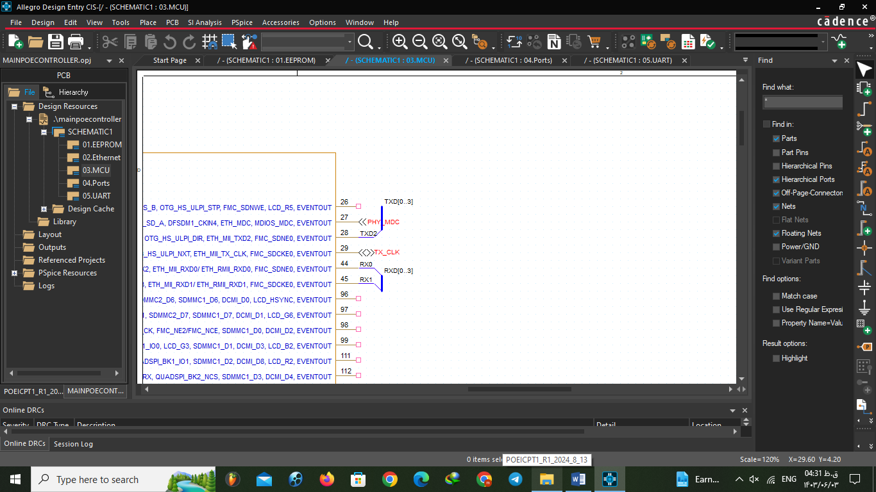
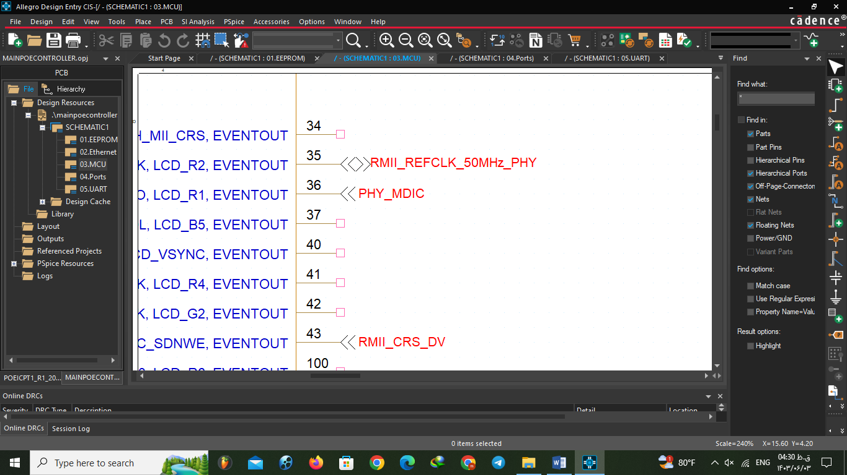
03:MCU
This time power pins of MCU were not connected.

Slide 10
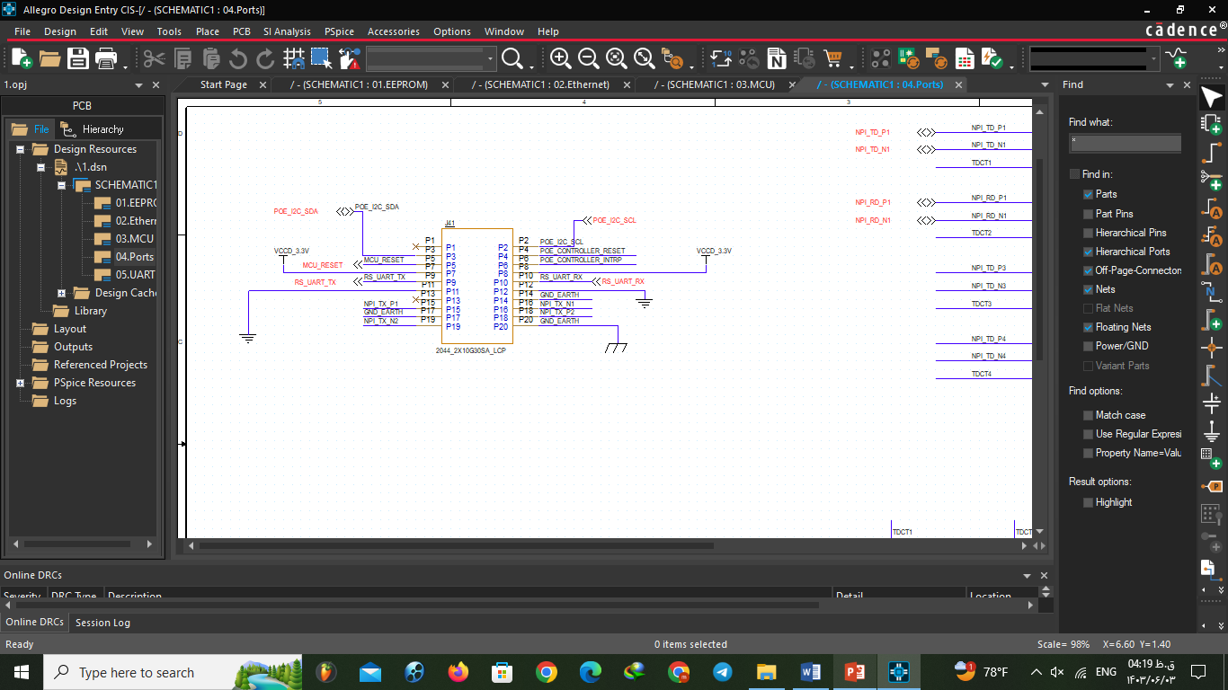
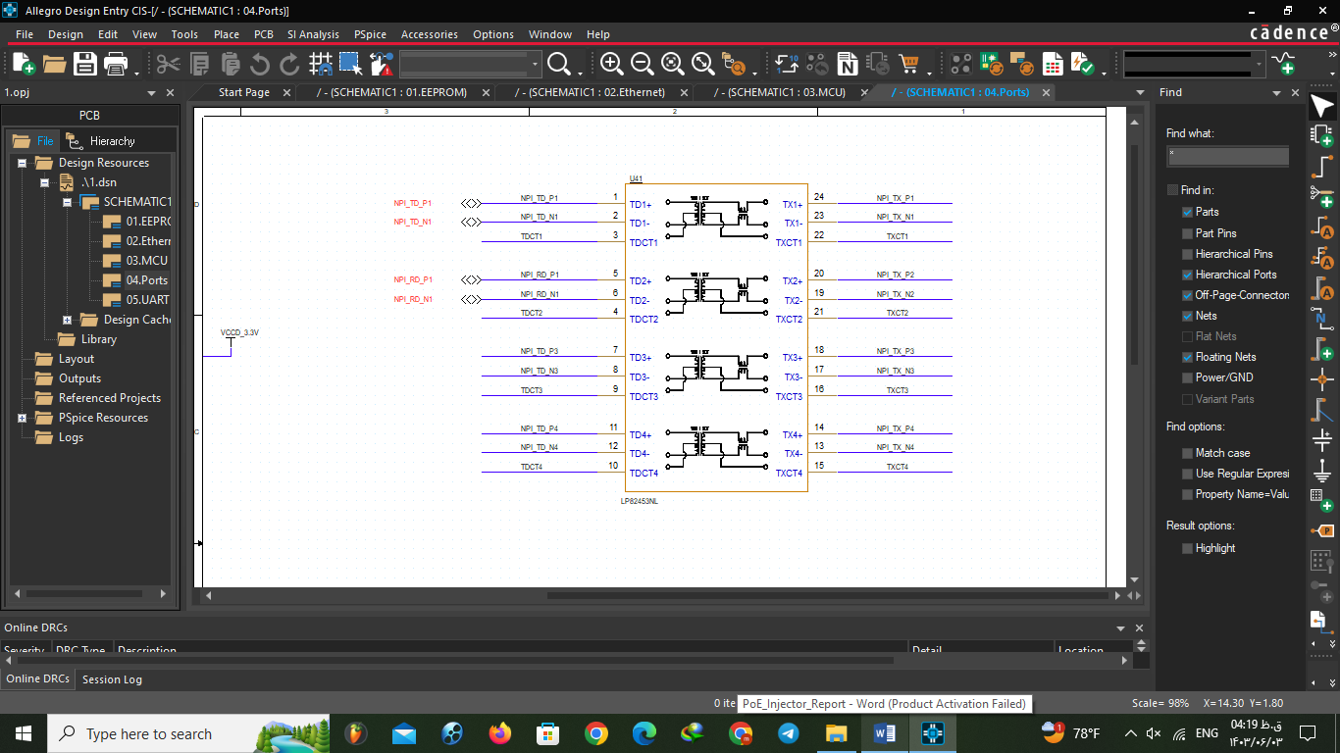
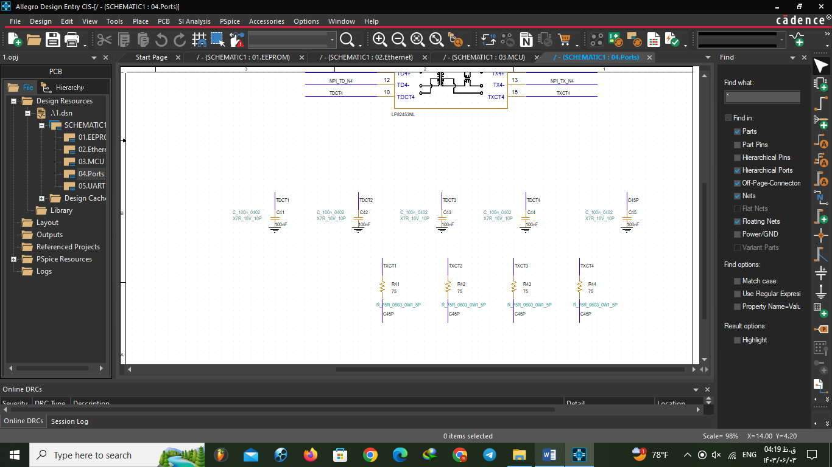
04:Ports

Slide 11
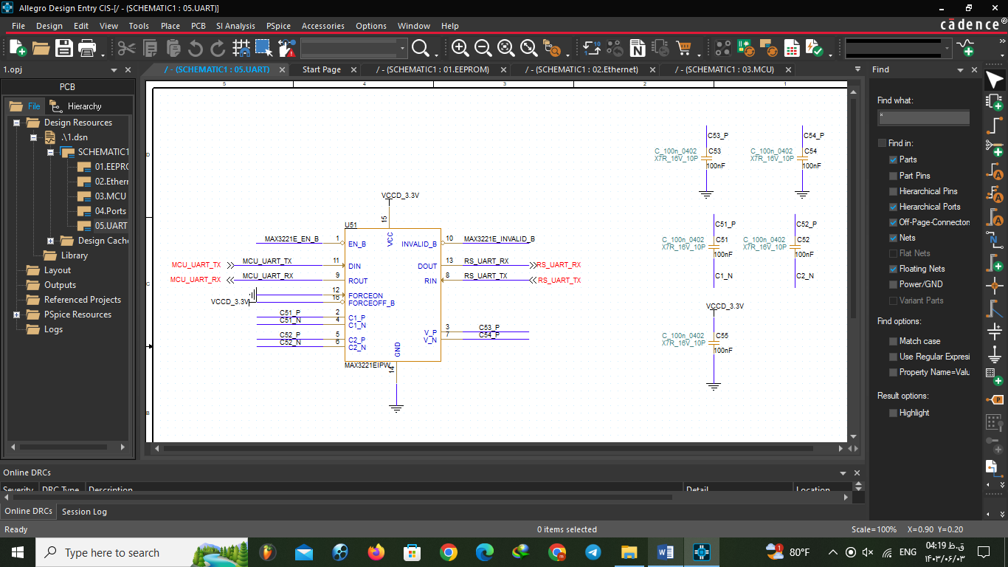
05:URT

Slide 12
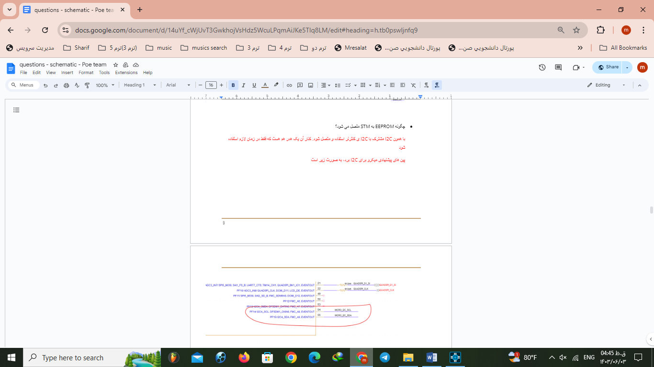
Milestones:
For this part we used a creative method. We made a google doc with our mentor and we asked our questions there with picture and she answered us with red color. Again we asked new questions with blue color and mentor answered. It was very efficient way.
01:EEPROM

Slide 13
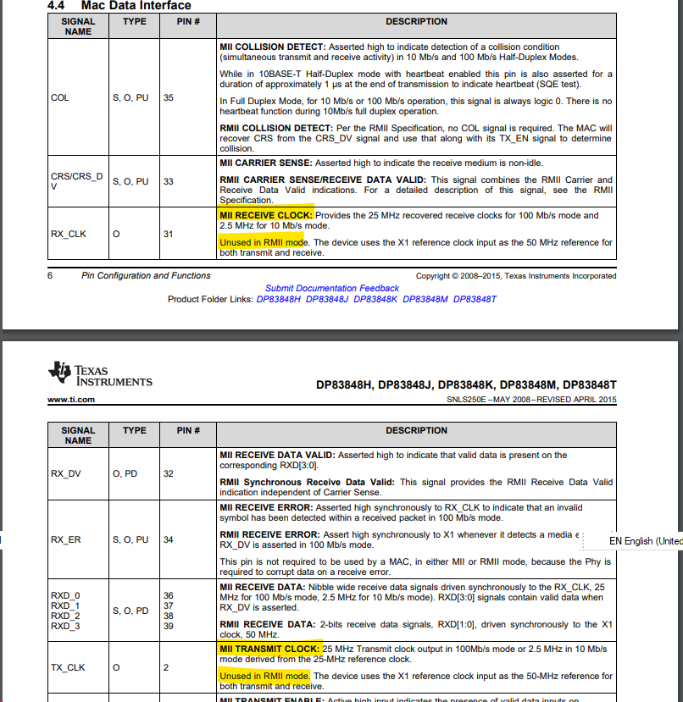
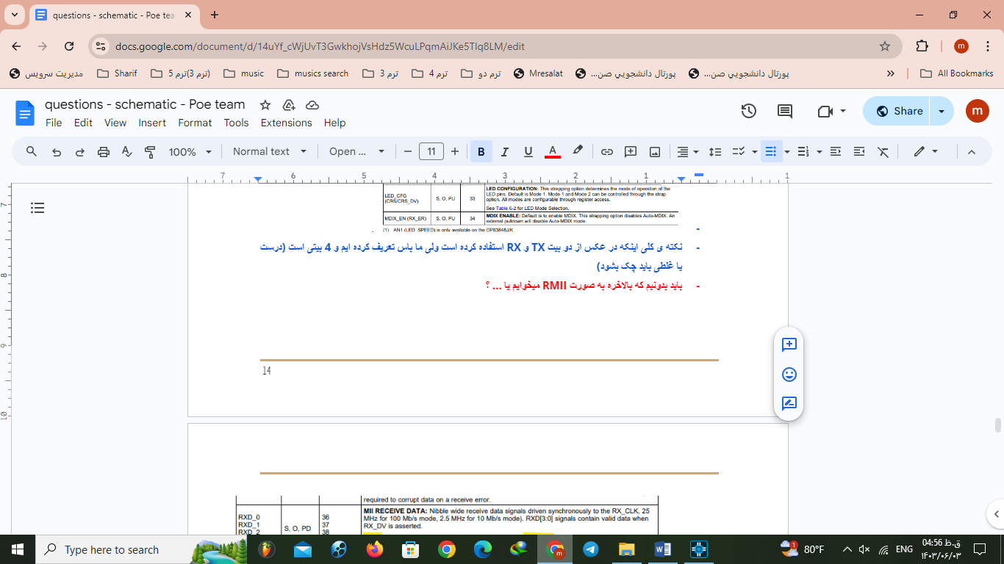
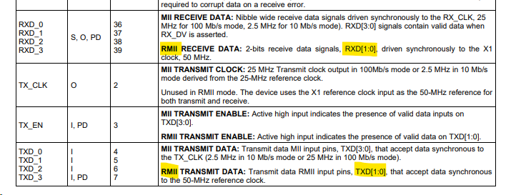
02:Ethernet

Slide 14
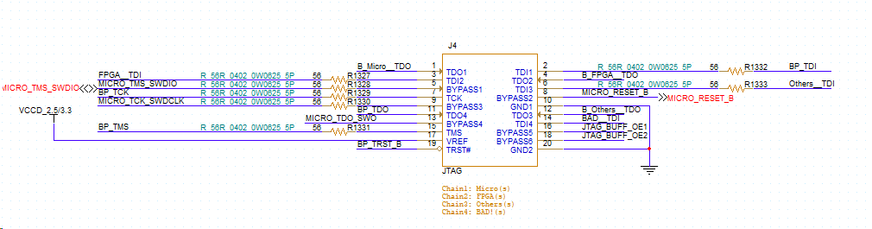
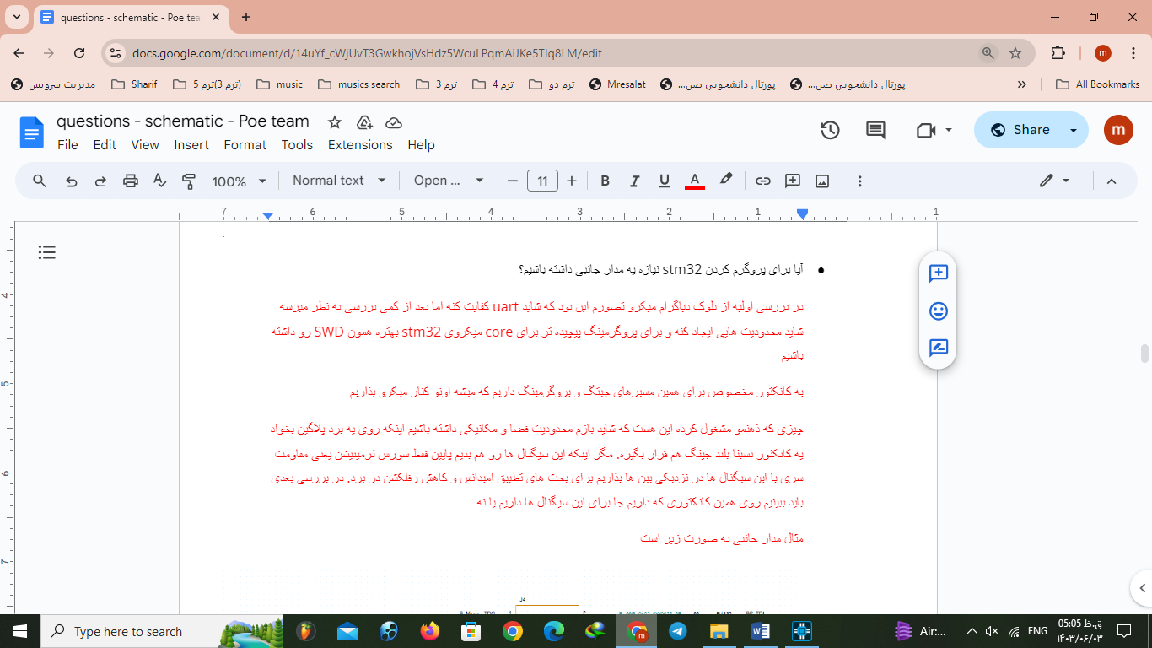
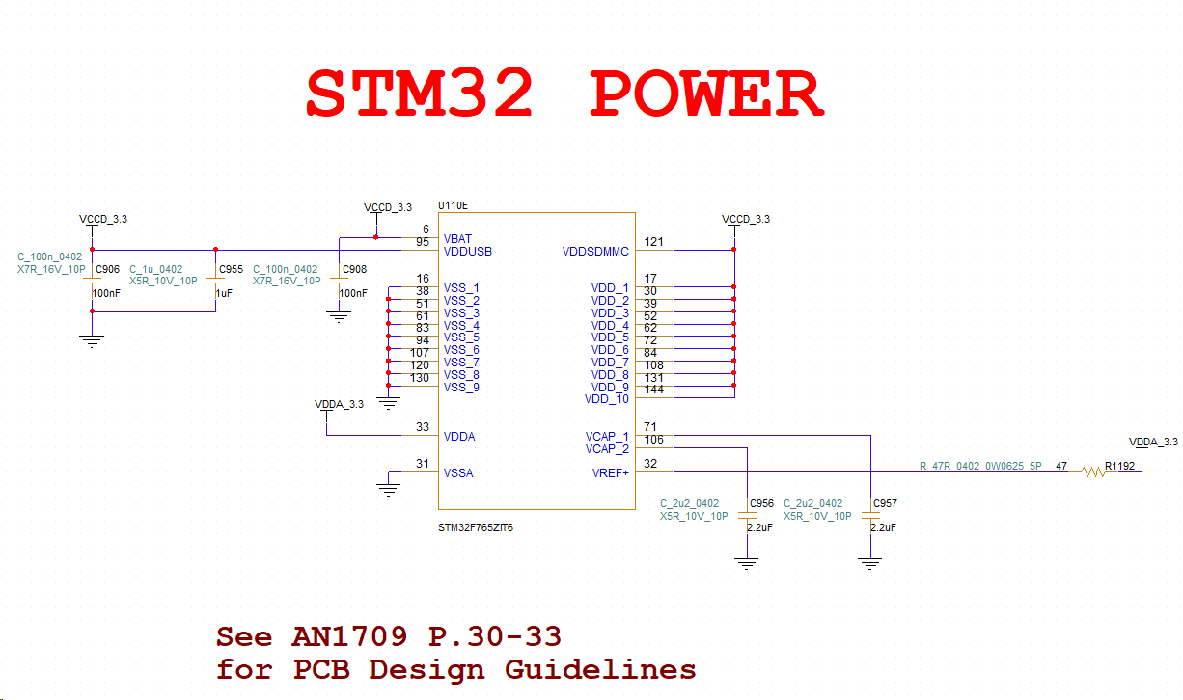
03:MCU

Slide 15
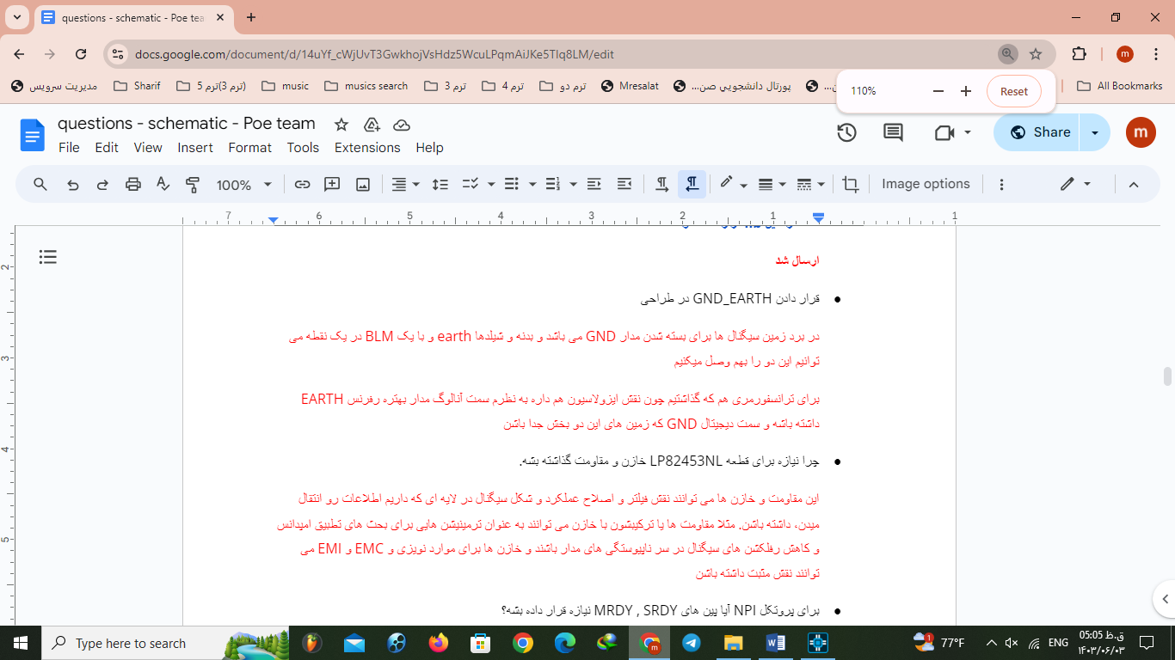
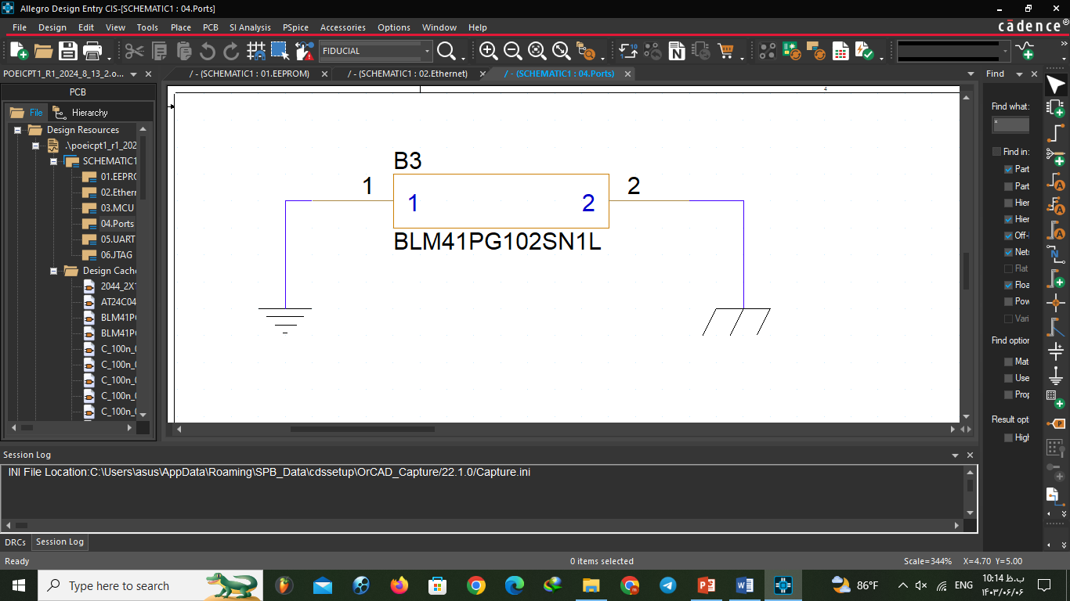
04:Ports

Slide 16
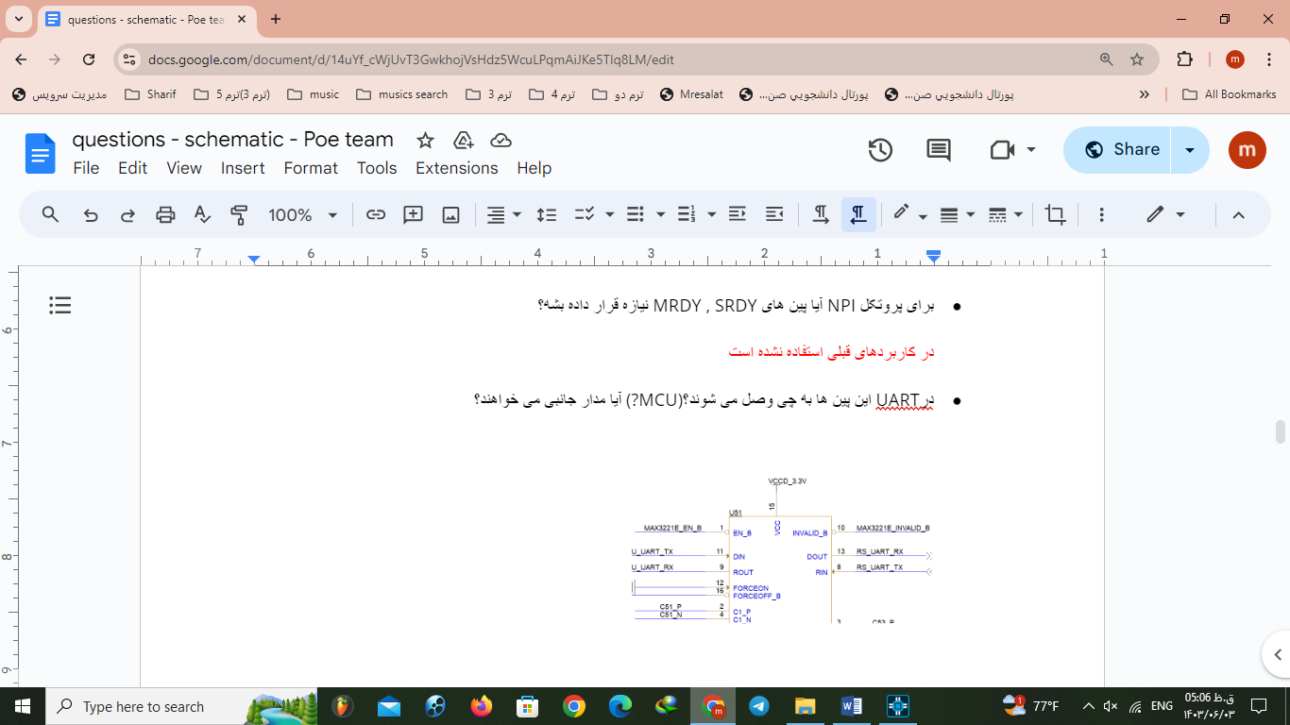
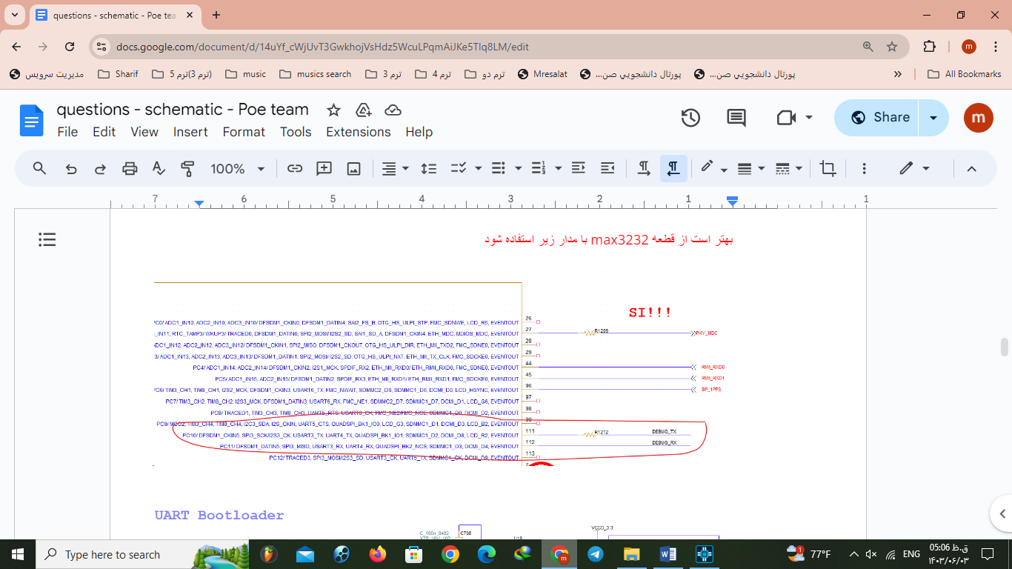
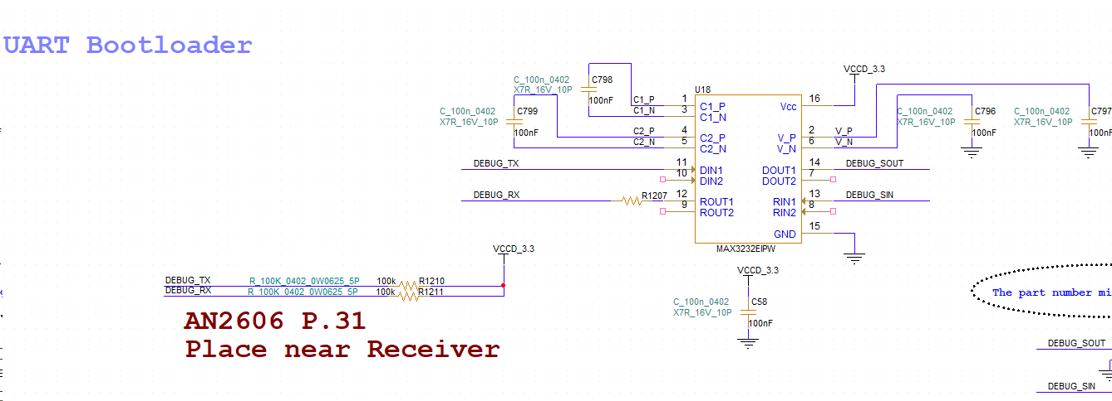
05:URT

Slide 17
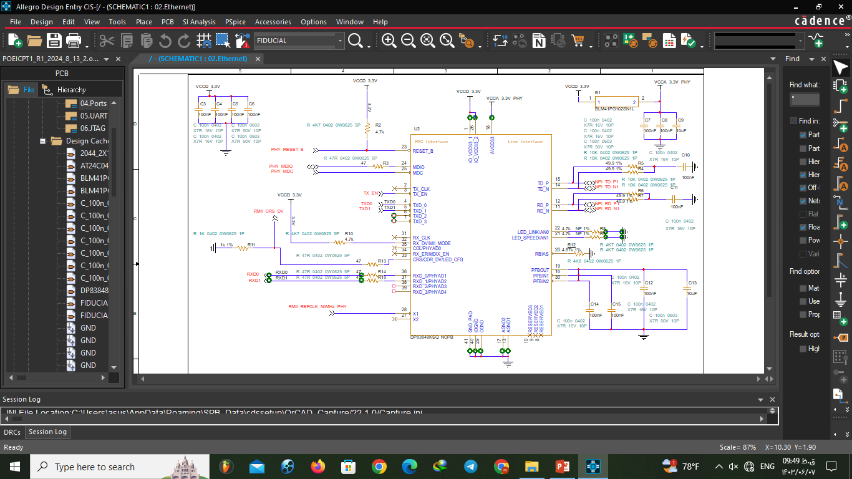
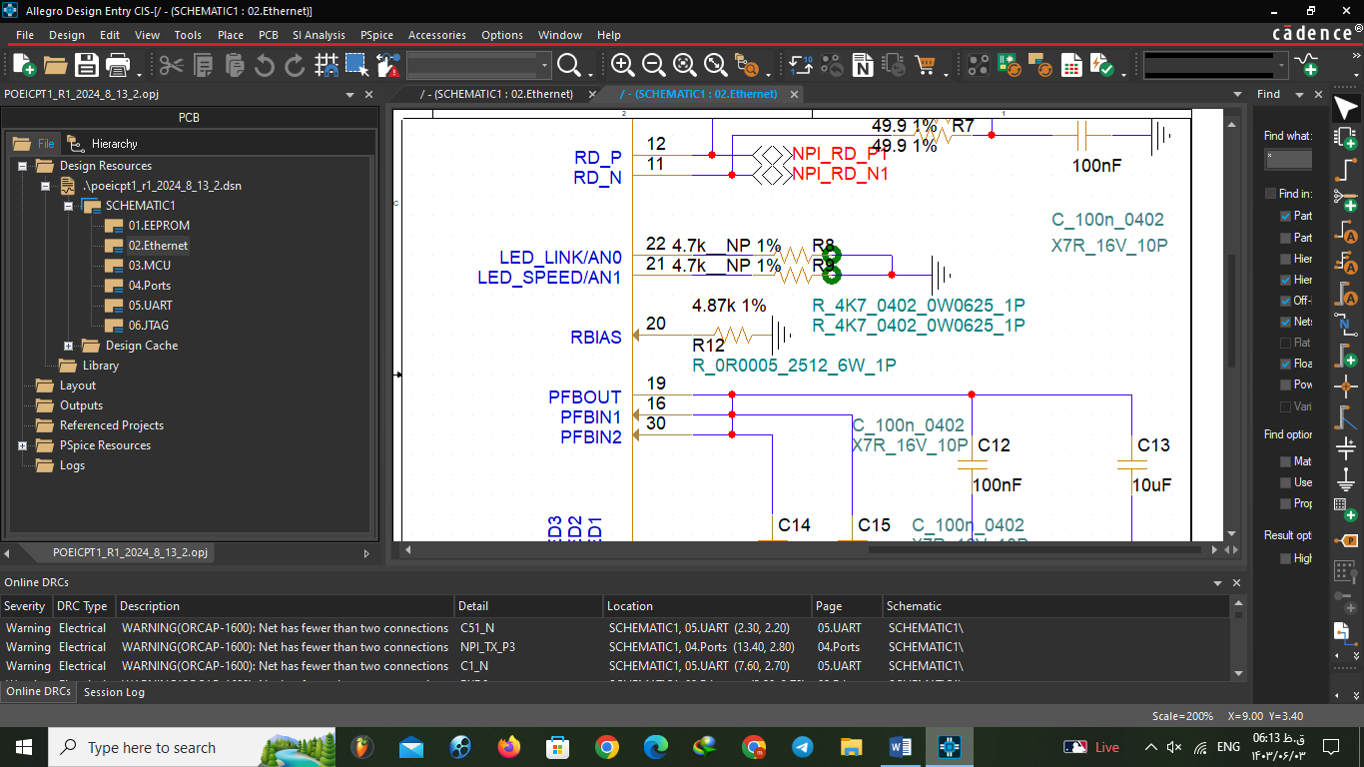
LAST Design: ethErNet

Slide 18
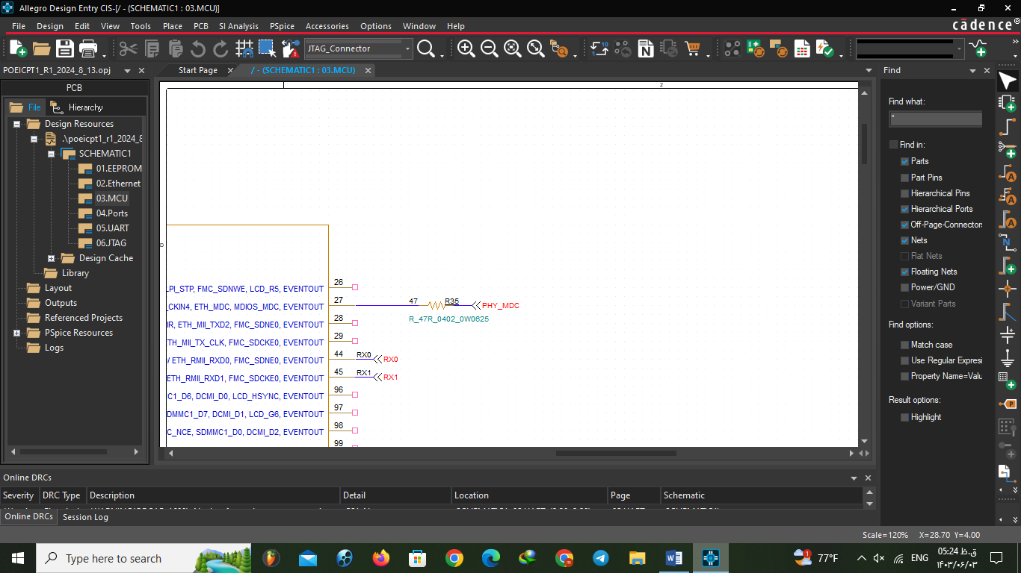
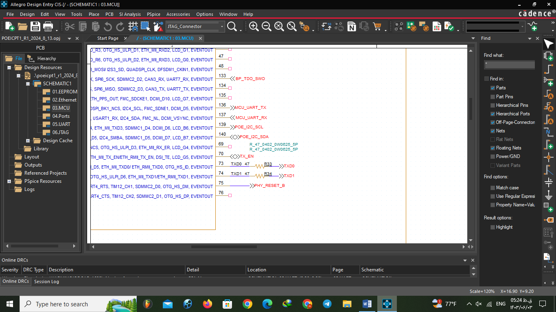
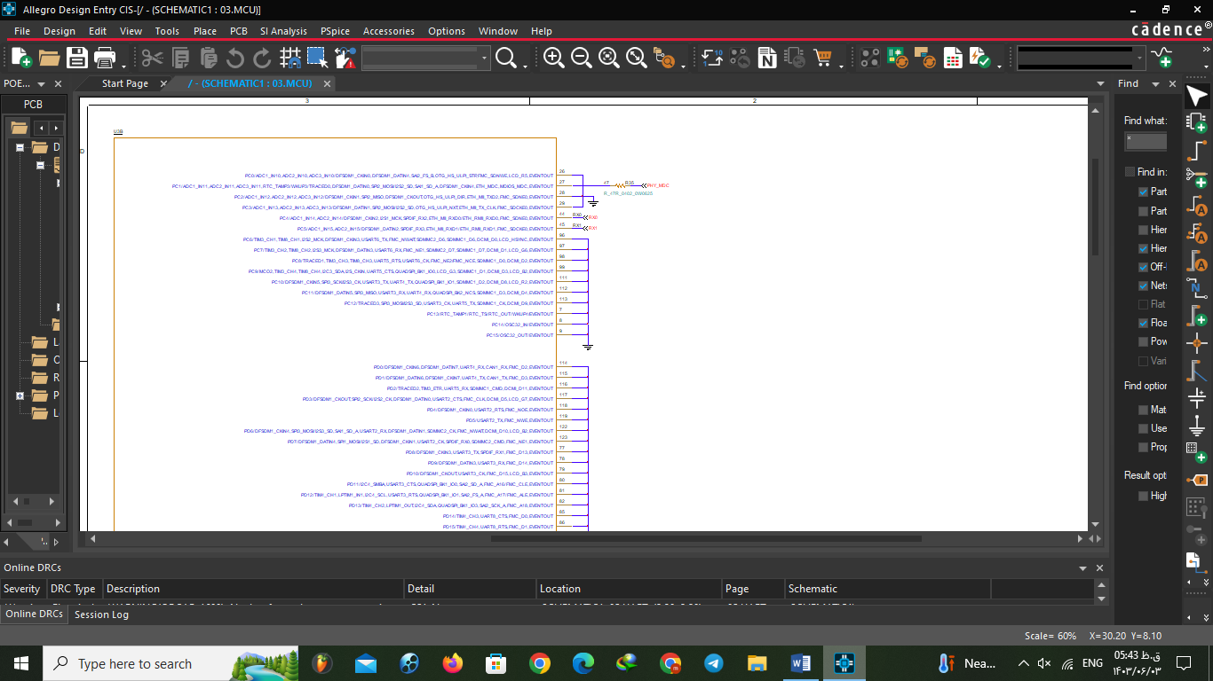
MCU

Slide 19
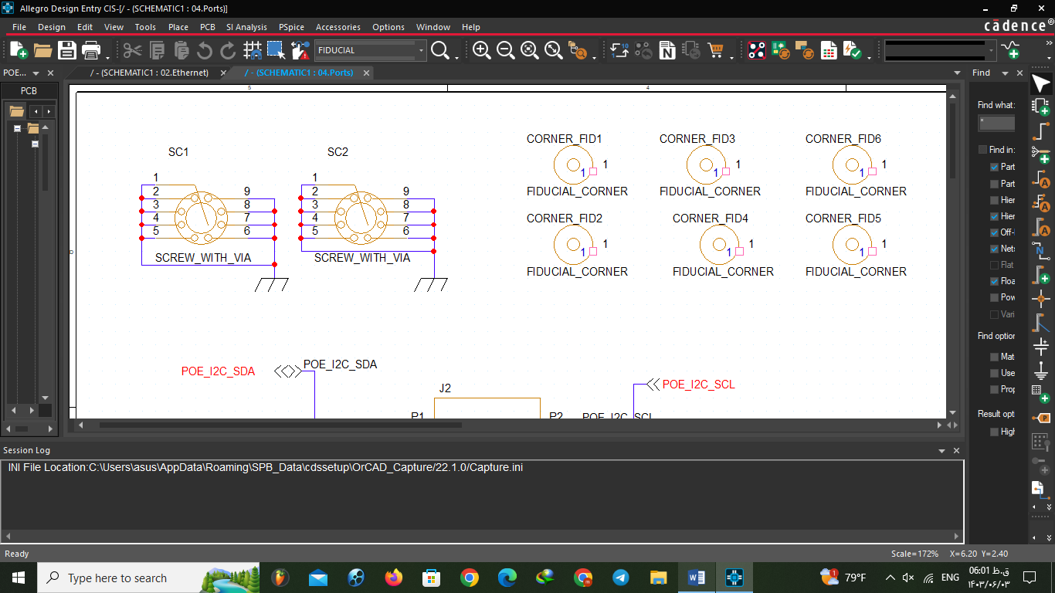
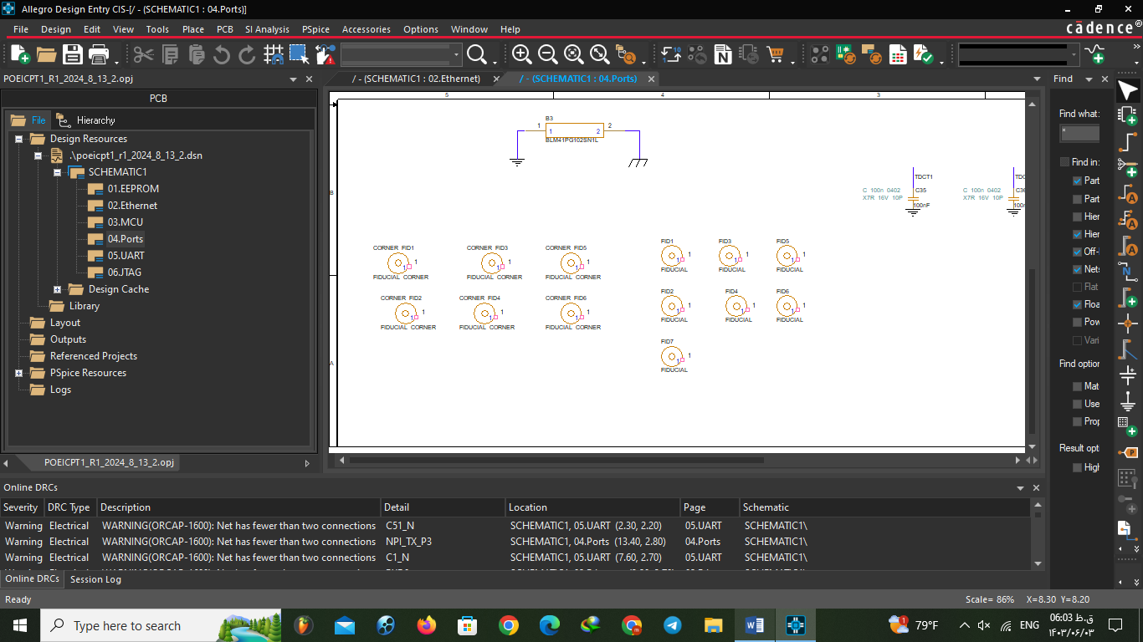
pORTS

Slide 20
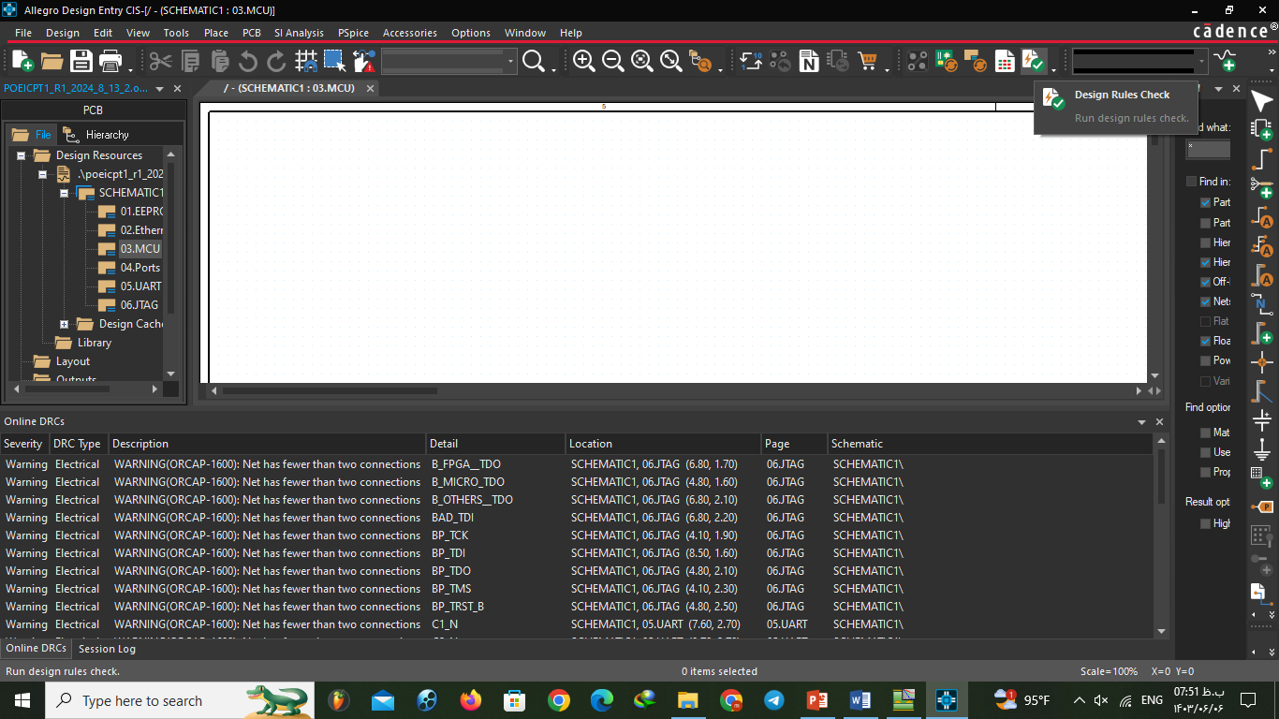
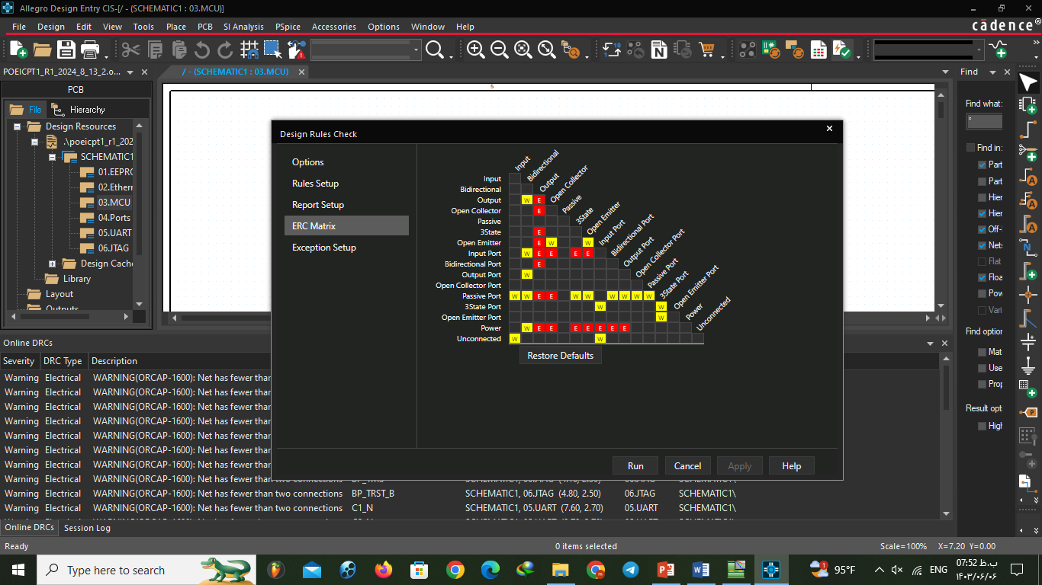
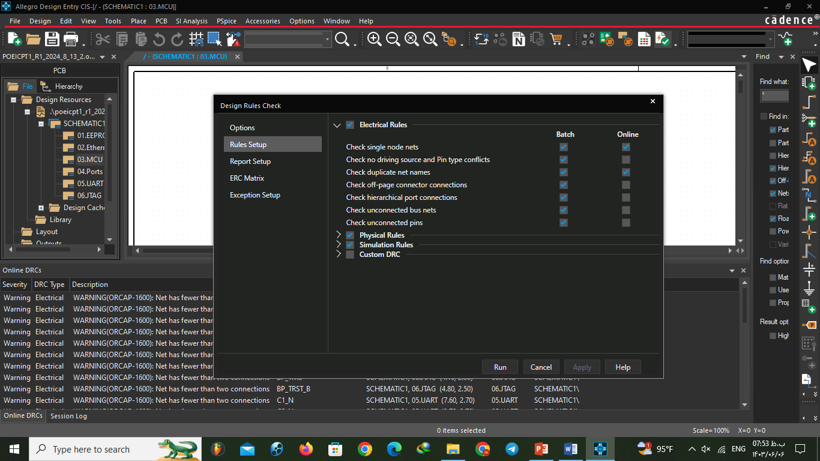

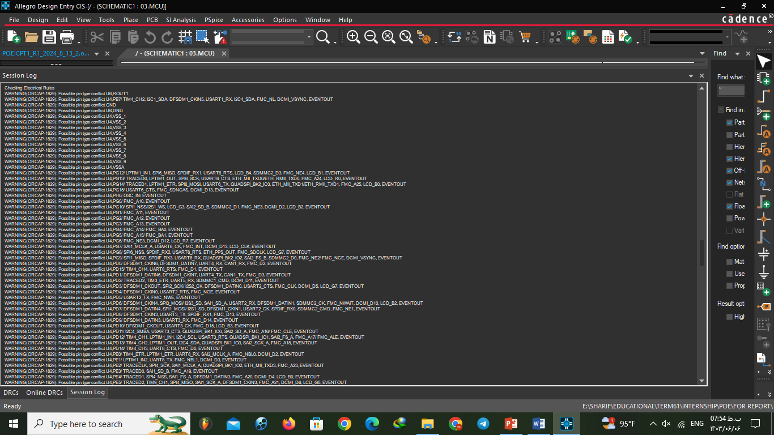
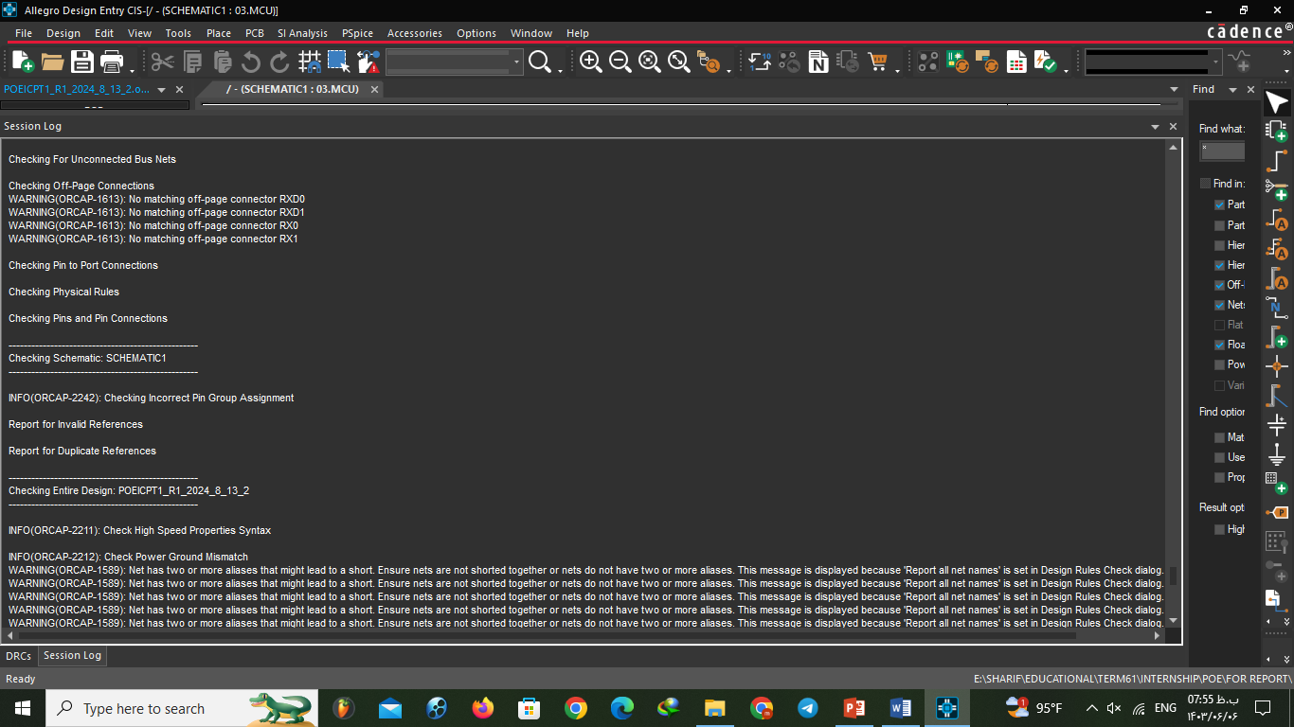
PCB
Before making layout we should do some checks in schematic part. Checking rules and connections.
Also setting ERC matrix is good for find and setup all possible the errors in our board.

Slide 21
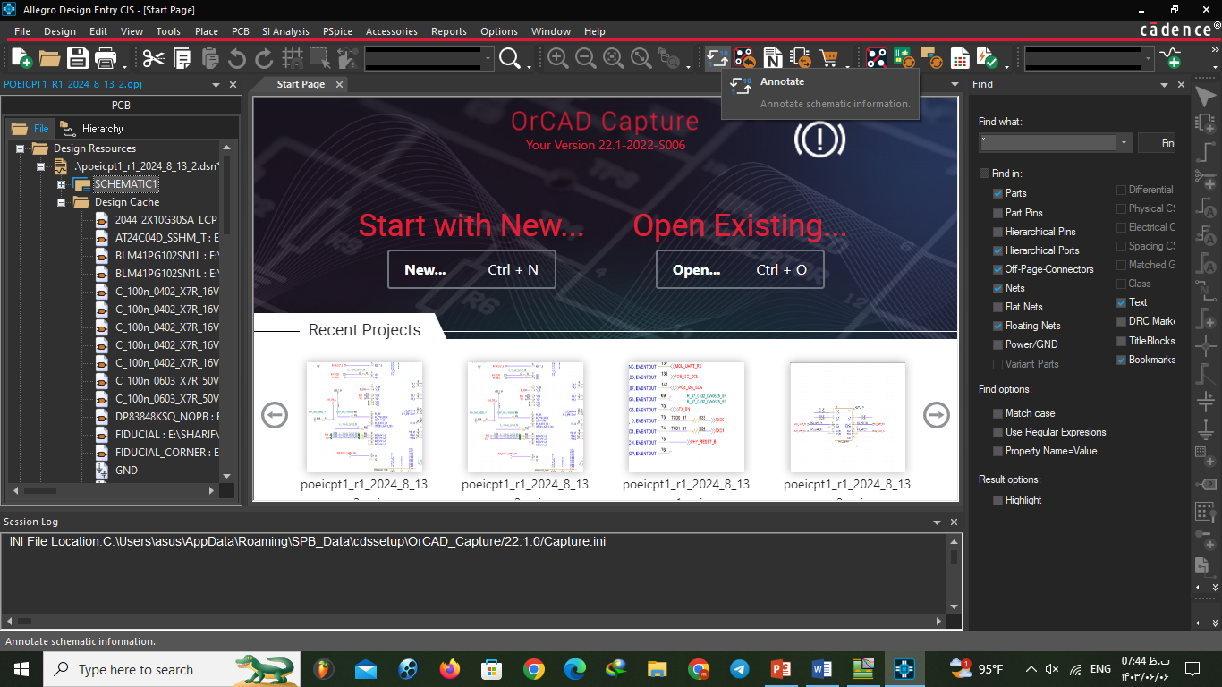
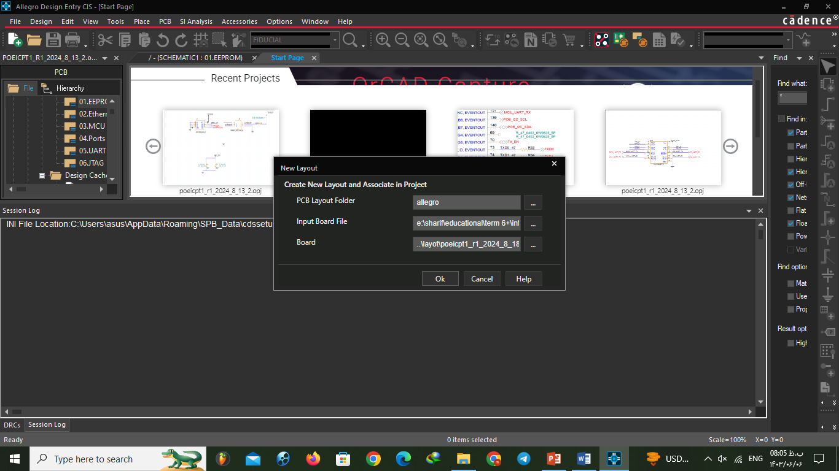
Putting all elements in order with annotate:
Now is time to make layout.
(Every time you make changes in schematic you should do this and you should update you layout. But first time just make a file as input)

Slide 22
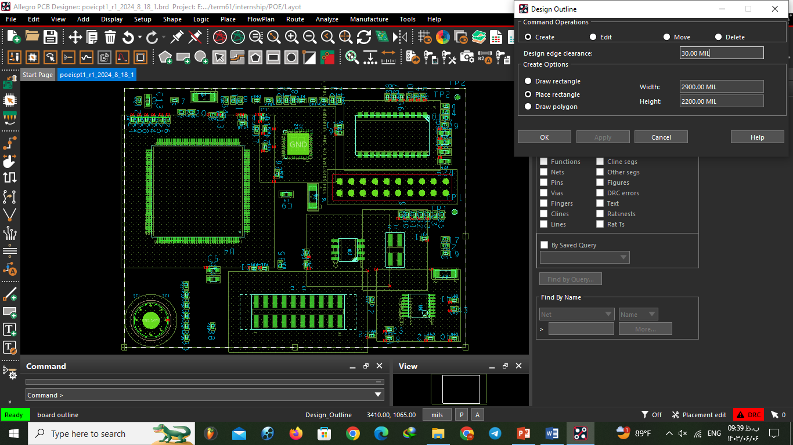
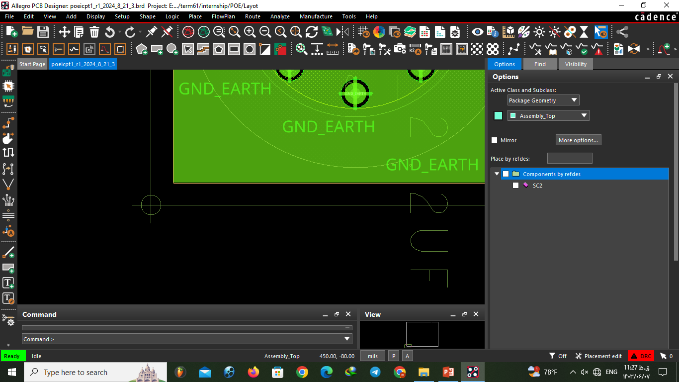
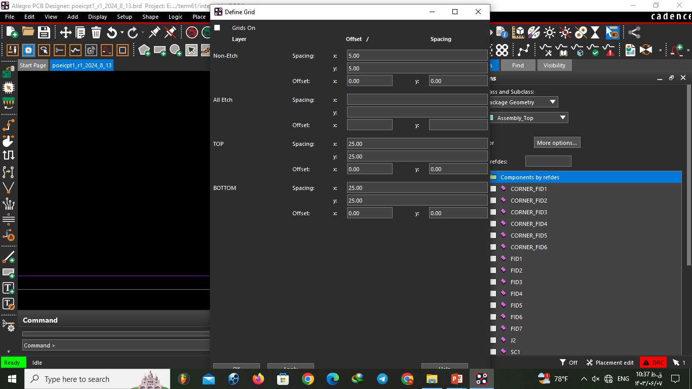
PCB DESIGN
Our board has two layers and we will be tell about designing in two layers top and bottom. But we can add new layer if we want.
Size and distance in cadence is based on MILS (mili inches) but you can change it.
At the first you need to draw a outline for your board
(Our board should be 7.5cm x 5.5cm and we converted it to MILS)
2900 X 2200 MILS , 30MIL Edge Clearance
Then you set your coordinates and grid (Typically in left bottom corner of outline)

Slide 23
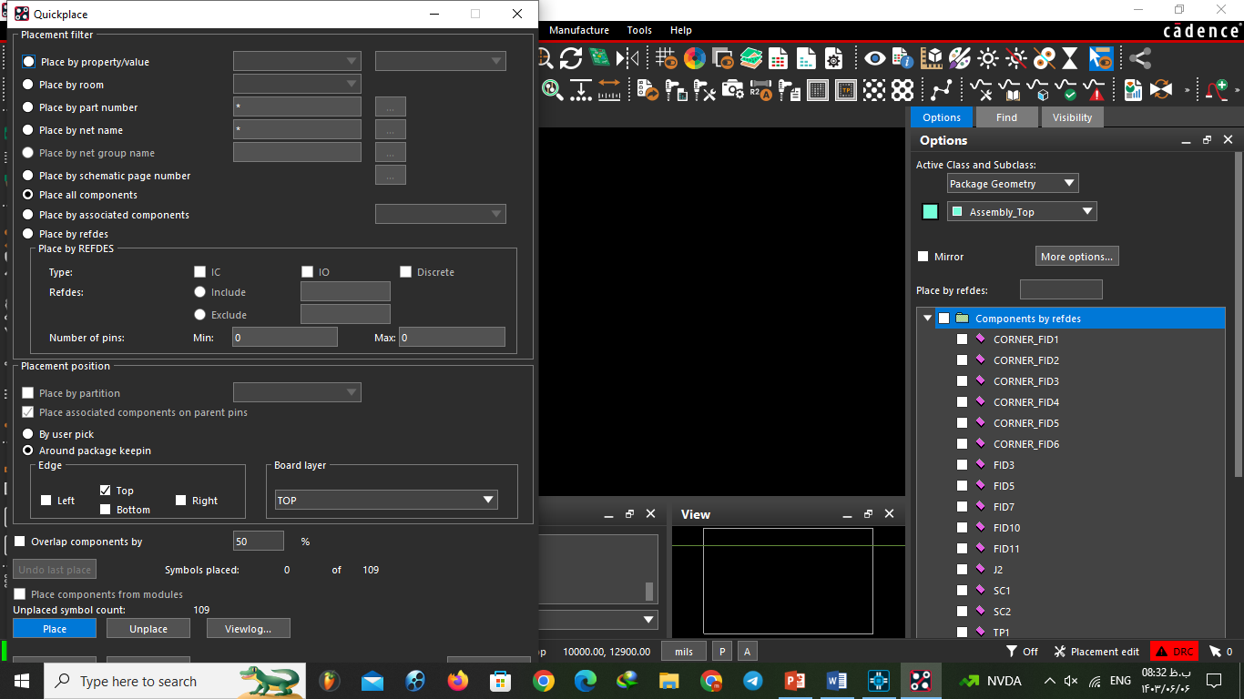
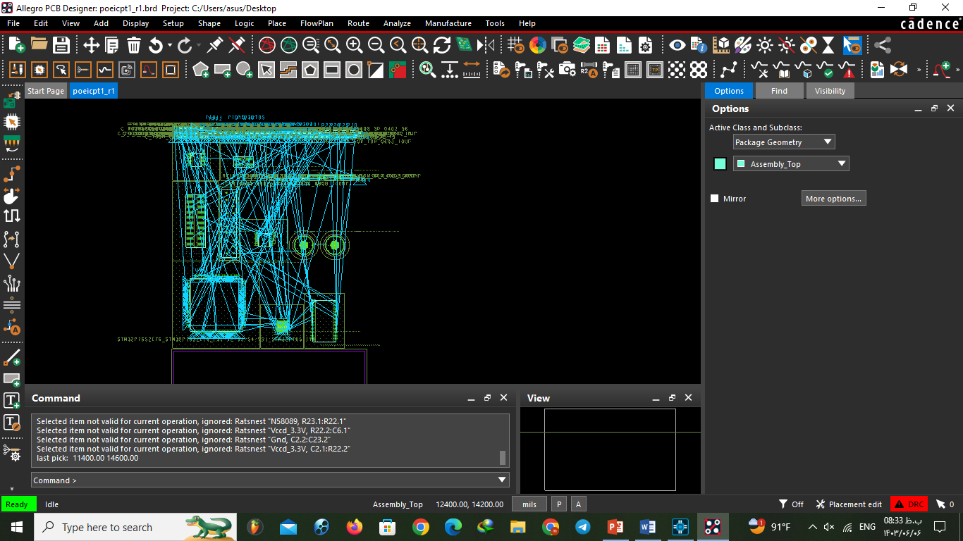
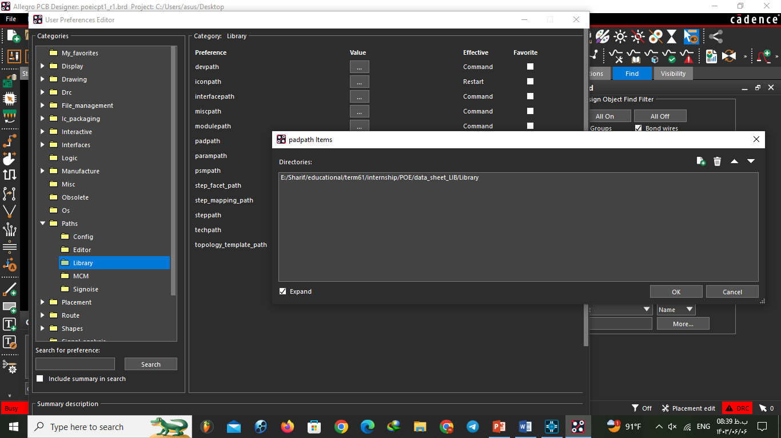
Here you need to have devices footprints and you should add them to your board file.
Then you place parts like this

Slide 24

Cadence features: find menu

Slide 25



Visibility Menu

Slide 26





Slide 27

xsection

Slide 28


Placement Mode

Slide 29




Schematic debugging during pcb design

Slide 30


sTANdARDs of placement
- DISTANCE:
Between resistors : 20MILS
Between resistors and IC: 100 MILS
Between two SMD IC: 150 MILS
Between IC and Through whole: 200 MILS
Corner fiducials distance from outline corners : 3 MILS

Slide 31

One of our PLACEMENTs

Slide 32



Etch mode: Drawing WIRES

Slide 33

Polar software: (etch PART STANDARDS)
We used Polar software to calculate widths and impedance of wires.

Slide 34

Then we set constraint to prevent errors

Slide 35


LOGIC
Identify DC nets

Slide 36




PLANE FOR GND ,GND_EARTH, VCC
We do this because it not good to use wires for power and also it makes our PCB less complicated

Slide 37



VIAS
It is a hole in the board to have connection between pins in to different layers.
In our board we used it for:
VCC (Because our VCC plane is on the bottom layer) bottom resistors.
For pin which need to be connect from bottom layer
Bottom resistors
Standards:
We added special feature to software folder (pcbenv) and then used it in software
For Power Pins: 16
For Signal Pins: 12

Slide 38

Special problems we got:
Some GND pins isn’t connected to plane because of other pins wires.

Slide 39

Latest design

Slide 40



Slide 41
Thank you!

